Slide 1
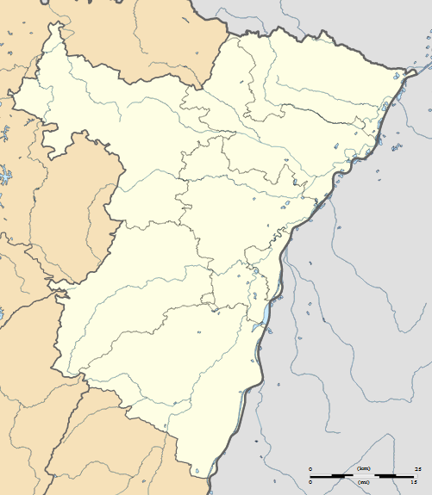
LAUTERBOURG WISSEMBOURG
DRUSENHEIM
SAVERNE
HAGUENAU
R.C.STRASBOURG
AS CHEMINOTS
MUTZIG/MOLSHEIM
ILLKIRCH
www.rugby67.fr
SELESTAT

